Slide 1
Software Quality Engineering
Peer Reviews

Slide 2
Peer Reviews
Contents:
  Introduction to Peer Reviews (What)
  Importance of Peer Reviews (Why)
  The Formality Spectrum
  Introduction to the Types of Peer Reviews
  What to Review ?
  Who will Review ?
  Conclusions

Slide 3
Peer Reviews
Introduction to Peer Reviews:
  In a peer review, co-workers of a person who created a software work product examine that product to identify defects and correct shortcomings
  A peer review:
    Verifies whether the work product correctly satisfies the specifications found in any predecessor work product, such as requirements or design documents
    Identifies any deviation from standards, including issues that may affect maintainability of the software
    Suggests improvement opportunities to the author
    Promotes the exchange of techniques and education of the participants.

Slide 4
Peer Reviews
Importance of Peer Reviews:
  Peer reviews, analysis tools and testing catch different classes of defects at different points in the development cycle
  Peer reviews catch 60 percent of the defects (approx)
    Given that finding and fixing most defects earlier in the project development cycle is more cost-effective than finding them later, we seek techniques that find defects as early as possible.
    Numerous studies confirm that peer review provides an effective technique that catches from 31 to 93 percent of the defects, with a median of around 60 percent.
  Perspective-based reviews catch 35 percent more defects than non-directed reviews
    The union of several perspectives into a single inspection offers broad yet focused coverage of the document being reviewed

Slide 5
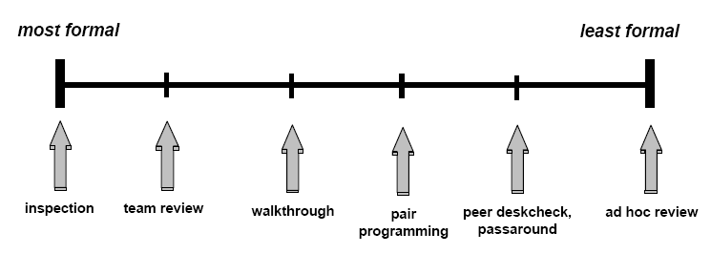
Peer Reviews
The Formality Spectrum (Illustrated)

Slide 6
Peer Reviews
Types of Peer Reviews:
  Ad-Hoc Review:
    Ad hoc reviews are the most informal type of review
    They have little impact beyond solving the immediate problem
    Normally takes the form of one person asking one of his colleagues/friend to spend a few minutes helping to track down an elusive specification (bug etc.)
These are the spur of the moment meetings where you call a coworker to your desk to help with a small problem. Usually just solves an immediate problem. (This is super useful when trying to work out various coordinate transforms)

Slide 7
Peer Reviews
  Peer Deskcheck
    The peer deskcheck is the cheapest review approach
    It involves only one reviewer’s time, which might include a follow-up discussion with the author to explain the reviewer’s findings
    A peer deskcheck depends entirely on the single reviewer’s knowledge, skill and self discipline, so expect wide variability in results
    Peer deskchecks provide a good way to begin developing a review culture.
    In addition to providing a quality filter, such reviews provide a coaching opportunity to pass along tips for better ways to do things the next time.

Slide 8
Peer Reviews
Types of Peer Reviews:
  Peer Deskcheck (contd)
Peer passaround/deskcheck, – In this approach a copy of the work is sent to multiple reviewers, after which you can then collate all of the reviews. This lets multiple people look at the code/item, and also lets you get something if one person does not respond. In the peer deskcheck version only one person looks at it instead of passing it around for multiple reviews.

Slide 9
Peer Reviews
Types of Peer Reviews:
  Passaround:
    A Passaround or distribution is a multiple, concurrent peer deskcheck.
    Instead of asking just one colleague for input, you deliver a copy of the product to several people and collate their feedback
    The passaround helps mitigate two major risks of a peer deskcheck: the reviewer failing to provide timely feedback and the reviewer doing a poor job
    However, a passaround still lacks the mental stimulation that a group discussion can provide

Slide 10
Peer Reviews
Types of Peer Reviews:
  Walkthrough: (1/4)
    A walkthrough is an informal review in which the author of a work product describes the product to a group of peers and solicits comments
    The author takes the dominant role; other specific review roles are usually not defined
    Walkthroughs are informal because they typically do not follow a defined procedure
    Its Goals include :
      Finding Problems
      Reaching a shared understanding and agreement as to the module’s purpose, structure, and implementation

Slide 11
Peer Reviews
Types of Peer Reviews:
  Walkthrough: (contd) (2/4)
    Authors can use walkthroughs to test their ideas, brainstorm alternative solutions, and stimulate the creative aspects of the development process
    Walkthroughs are a good way to evaluate test documentation
    The author can lead the team through the test cases to reach a shared understanding of how the system should behave under specified conditions.
    Usability walkthroughs are a tool for evaluating a user interface design from a human factors perspective

Slide 12
Peer Reviews
Types of Peer Reviews:
  Walkthrough: (contd) (3/4)
    Another walkthrough strategy involves following a script that describes a specific task or scenario to illustrate how the system would function during a sample user session.
    This technique helps a group of customers, requirements analysts, and developers reach a common understanding of system behavior.
    It can also reveal errors in early deliverables such as requirements specifications

Slide 13
Peer Reviews
Types of Peer Reviews:
  Walkthrough: (contd) (4/4)
    The domination by the author and the unstructured approach render them a less valuable defect filter than inspections or team reviews
    One report from Ford Motor Company indicated that inspections found 50 percent more defects per thousand lines of code than did walkthroughs

Slide 14
Peer Reviews
Types of Peer Reviews:
  Team Review:
    Team reviews are a type of “inspection-lite,” being planned and structured but less formal and less rigorous than inspections
    A team review allows a group of qualified people to judge whether a product is suitable for use and to identify ways in which the product does not satisfy its specifications
    Team reviews follow several of the steps found in an inspection (author is not the leader and some roles are defined)
    Although little published data is available, one industry study found that this type of team review discovered only two-thirds as many defects per hour as inspections revealed
    This is similar to the walkthrough however reviewers are provided with documentation/code in advance to review and their results are collated.

Slide 15
Peer Reviews
Types of Peer Reviews:
  Inspection (1/2)
    An inspection is the most systematic and rigorous type of peer review
    Inspection follows a multistage process with specific roles assigned to individual participants
    A common inspection process includes seven stages: planning, overview, preparation, meeting, rework, follow-up, and causal analysis
    Inspectors should be trained in the inspection process so they can perform the various participant roles
    Inspections rely on checklists of defects commonly found in different types of software work products and other analytical techniques to search for bugs.

Slide 16
Peer Reviews
Types of Peer Reviews:
  Inspection (2/2)
    An important aspect of an inspection is that participants other than the work product’s author lead the meeting (inspection role of moderator), present the material to the inspection team (reader), and document issues as they are brought up (recorder)
    Because several inspectors carefully scrutinize the product, inspection provides a good test of understandability and maintainability
    At the end of the inspection meeting, the team agrees on an appraisal of the work product and judges whether changes the author will make during rework must be verified through a second inspection

Slide 17
Peer Reviews
What to Review:
  All interim and final development work products are candidates for review, including:
    Requirements specifications
    User interface specifications and designs
    Architecture, high-level design, and detailed designs and models
    Source code
    Test plans, designs, cases, and procedures
    Software development plans, including project management plan, configuration management plan, and quality assurance plan

Slide 18
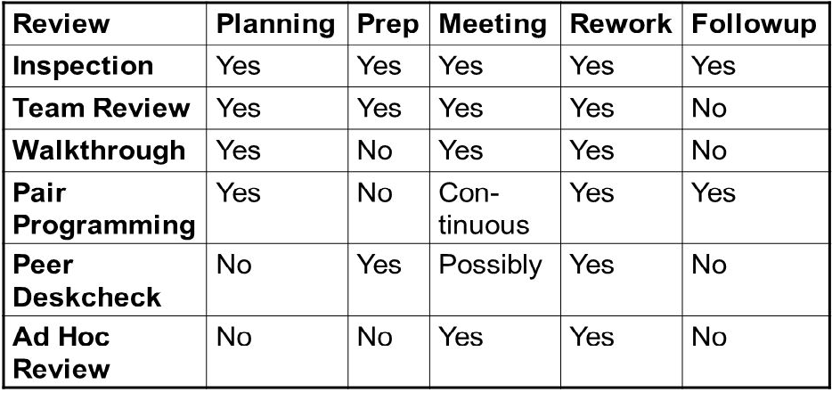
Formality Spectrum

Slide 19
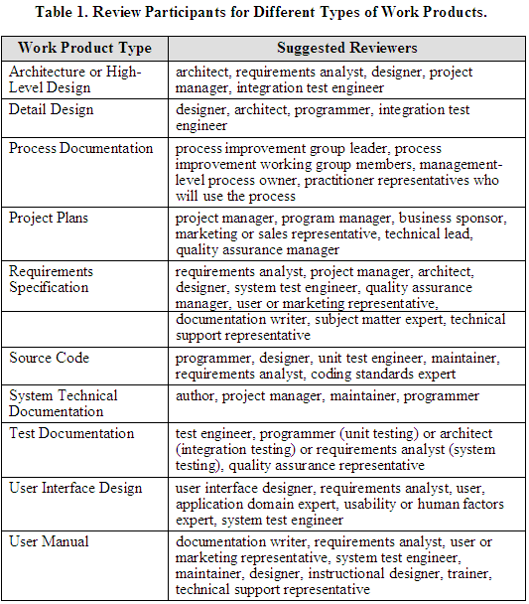
Peer Reviews
Who will Review:

Slide 20
Peer Reviews
Conclusions:
  In a peer review, co-workers of a person who created a software work product examine that product to identify defects and correct shortcomings
  A peer review:
    Verifies whether the work product correctly satisfies the specifications found in any predecessor work product, such as requirements or design documents
    Identifies any deviation from standards, including issues that may affect maintainability of the software
    Suggests improvement opportunities to the author
    Promotes the exchange of techniques and education of the participants.
  Peer Reviews are very effective instruments of catching defects early in the lifecycle of a software product (with some studies suggesting 31-93 % defects are caught in Peer Reviews)

Slide 21
Peer Reviews
Conclusions:
  Peer Reviews can be classified based on the level of Formality
  Types of Peer Reviews include Ad-Hoc Review, Peer Deskcheck, Passaround, Pair Programming, Walkthrough, Team Review and Inspection with Ad-Hoc being the least formal and Inspection being the most formal
  Every type of review has a specific benefit and is useful in specific circumstances. Thus, the organization should carefully choose the Peer Review type
  Inspections have proved to be the best practice in terms of reducing the number of defects (but it does not mean that only inspections should be done)

Slide 22
Peer Reviews
Conclusions:
  All interim and final development work products are candidates for review
  SQA Dept is usually involved in Peer Reviews for almost all types of Software Work Products
  Quality Control/Testing Engineer are a vital part of Team Reviews and Inspections and their input is extremely important
  In some circumstances, Testing Engineers take the lead role in Team Reviews and Inspections

